Slide 1
Grievance Management System

Slide 2
Our Objectives
Simplify the task of lodging and resolving grievances
Improve efficiency of the process
Reduce paperwork
Improve transparency
Reduce the physical intervention needed to pursue the procedure
Ease of handling multiple grievances in a short time

Slide 3
Modules
Students
AR
DR
COE
VC

Slide 4
1. Students
Functionalities include:
Login to the system with students' credential
Change of password
Posting grievances according to respective branch and the corresponding category for that branch.
Constraints on putting random grievances apart from the pre-defined ones.
Viewing progress of pending grievances

Slide 5
2. Assistant Registrar (AR)
Functionalities include:
Login to the system with AR's credentials(Different AR's have different credentials)
Change of password
Viewing grievances under the respective AR’s domain only
Reply to grievances by clicking on the reply button corresponding to the grievance mentioned.

Slide 6
3. Deputy Registrar (DR)
Functionalities include:
Login to the system with DR's credentials
Change of password
Receiving grievances which are not attended by the AR for 7 days
Notifying the AR about the grievances again

Slide 7
4. Controller of Examinations (COE)
Functionalities include:
Login to the system with COE’s credentials
Change of password
Receiving grievances which are not attended by the AR for 7 days and also not attended by the DR for 7 days
Notifying the DR about the grievances again

Slide 8
5. Vice Chancellor (VC)
Functionalities include:
Login to the system with VC’s credentials
Change of password
Receiving grievances not attended by the AR for 7 days, by the DR for 7 days and also by the COE for 7 days
Replying to the grievances received by notifying DR of the concerned section
Viewing the grievance management statistics on year by year basis

Slide 9
Process Flow Diagrams

Slide 10
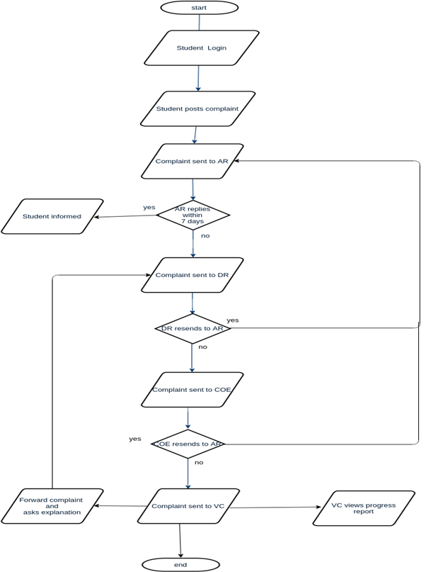

Slide 11
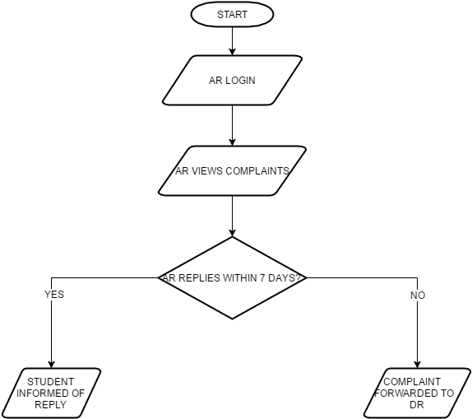
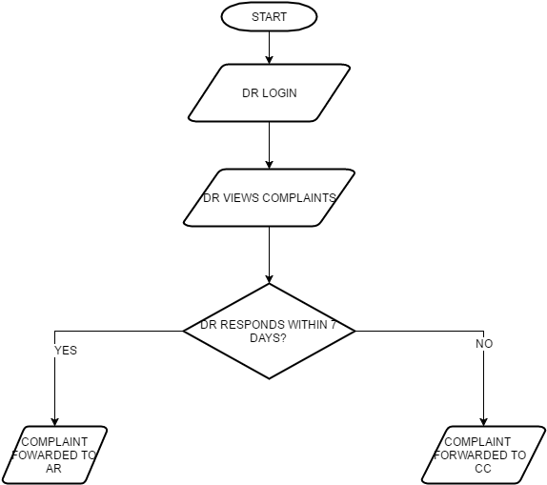
Process flow for AR
Process flow for DR

Slide 12
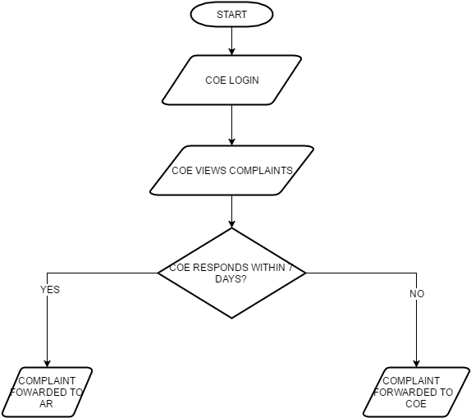
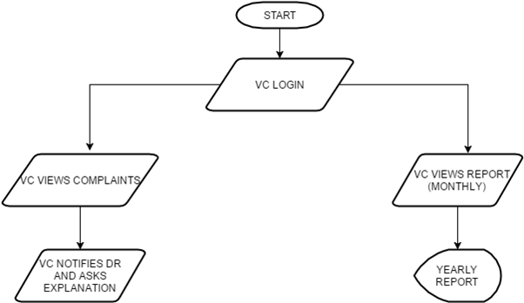
Process flow for COE
Process flow for VC

Slide 13
ScreenShots

Slide 14
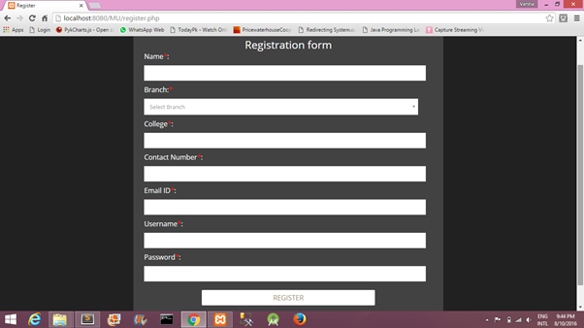
Fig 1: Registration Form

Slide 15
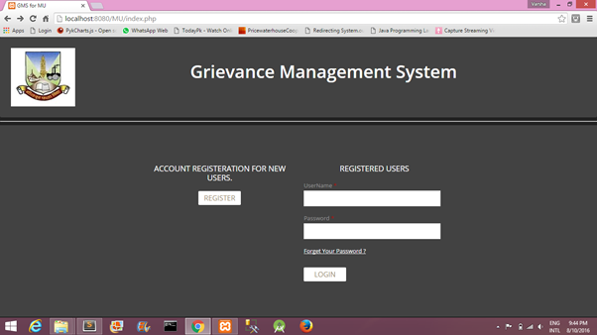
Fig 2: Login Page

Slide 16
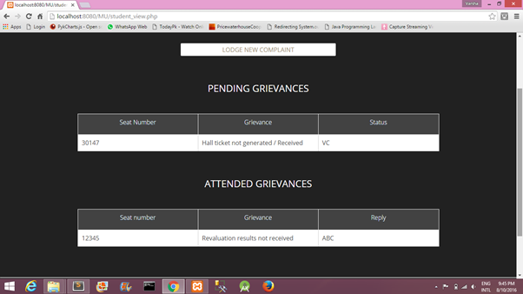
Fig 3: Details of Pending and Attended grievances

Slide 17
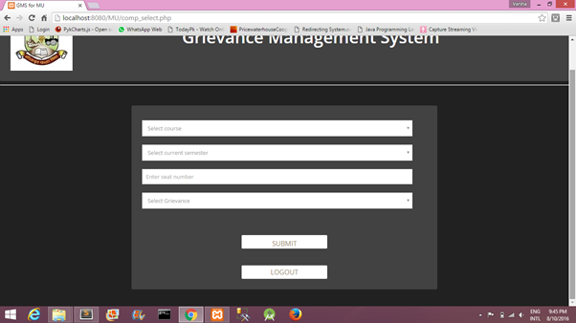
Fig 4: Lodge New Grievance Form

Slide 18
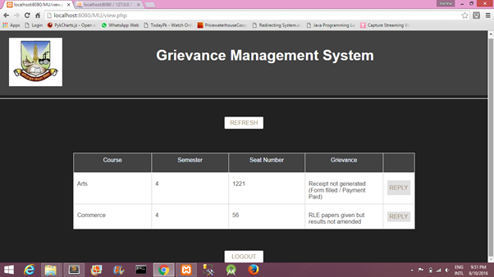
Fig 5: Details of grievances under AR with an option to reply for every grievance

Slide 19
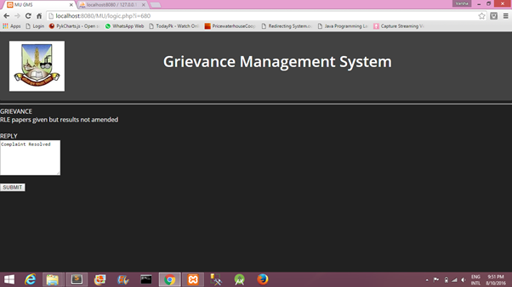
Fig 6: Reply form for AR

Slide 20
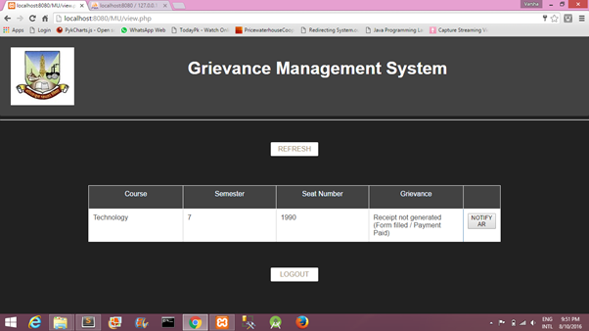
Fig 7: Details of grievances under DR with an option to Notify AR for every grievance

Slide 21
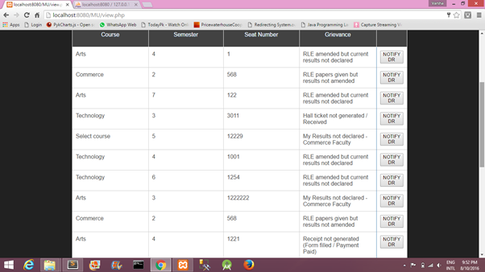
Fig 8: Details of grievances under VC with an option to Notify DR for each grievance

Slide 22
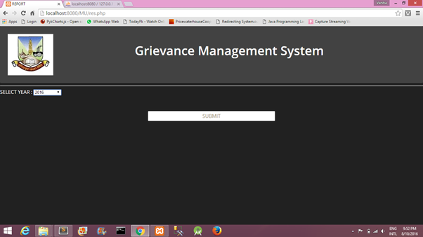
Fig 9: Selection of year to view report

Slide 23
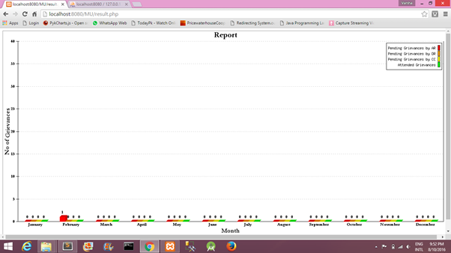
Fig 10: Graph displaying monthly records according to the selected year

Slide 24
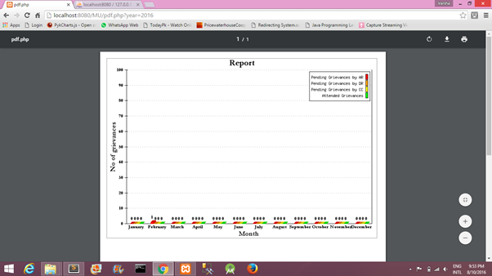
Fig 11: View reports as PDF and functionality to download it

Slide 25
Walkthrough

Slide 26
